Slide 1
Tittle

Slide 2
Dataset Description
Income level above // below $50,000 annual income
Dataset has 32,561 entries with 17 features including target
The features are:
'Age', 'Work_Class', 'fnlwgt:_continuous.', 'Eduction’, 'Education_Number', 'Martial_Status', 'Occupation’, 'Relationship’, 'Race', 'Sex', 'Capital_Gain', 'Capital_Loss’, 'Hours_Per_Wk’, 'Native_Country', 'Income_Level’, 'Hour_Class',

Slide 3
Project Plan
Cleaning data
Examine feature importance
Create pipeline: onehot encoder, standard scaler
Run through classifiers
Search for hyper parameters
Evaluate the model: Accuracy, confusion matrix

Slide 4
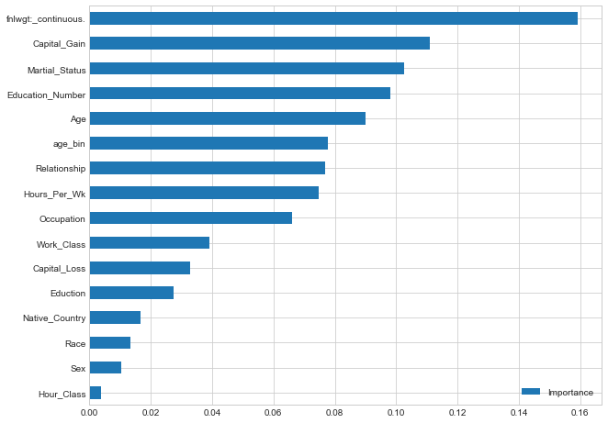
Feature Importance
Using Random Forest Classifier, we have calculated feature importance of the dataset

